Slide 1
Deadlock

Slide 2
A Deadlock is a situation where each of the computer process waits for a resource which is being assigned to some another process.
In this situation, none of the process gets executed since the resource it needs, is held by some other process which is also waiting for some other resource to be released.
In a computer system deadlocks arise when members of a group of processes which hold resources are blocked indefinitely from access to resources held by other processes within the group.

Slide 3
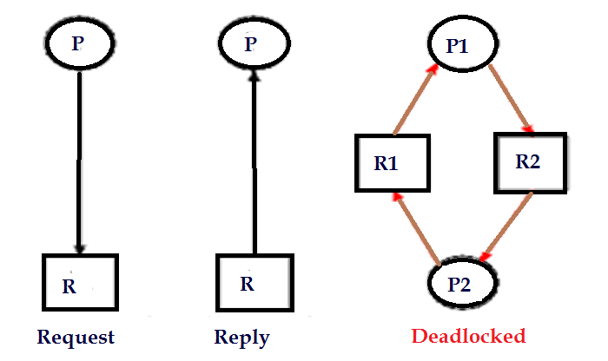
Deadlock Occurrence

Slide 4
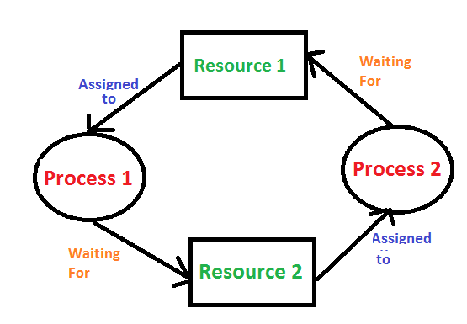

Slide 5
Simple Way Understand About Deadlock
Process1 requests resource A and receives it.
Process 2 requests resource B and receives it.
Process 1 requests resource B and is queued up, pending the release of B.
Process 2 requests resource A and is queued up, pending the release of A.

Slide 6

Deadlock Characterization
Deadlock Conditions
Systems Resource Allocation Graph
There are four conditions that are necessary to achieve deadlock:
1) Deadlock Conditions
i) Mutual Exclusion
In a multiprogramming environment, there may be several processes requesting the same resource at a time. The mutual exclusion condition, allow only a single process to access the resource at a time. While the other processes requesting the same resource must wait and delay their execution until it has been released. The mutual exclusion condition prevents two or more processes to access the same resource at a time.

Slide 7
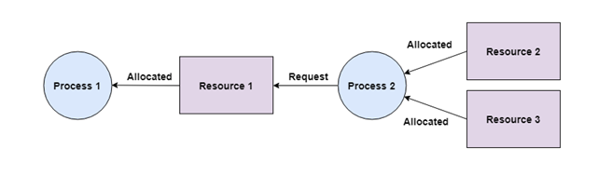
ii) Hold and wait
The hold and wait condition simply means that the process must be holding access to one resource and must be waiting to get hold of other resources that have been acquired by the other processes.

Slide 8
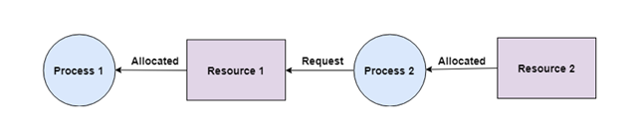
iii) No Preemption
A process acquiring a resource, cannot be preempted in between, to release the acquired resource. Instead, the process must voluntarily release the resource it has acquired when the task of the process has been completed.

Slide 9
iv) Circular Wait
The processes must be waiting in a circular pattern to acquire the resource. This is similar to hold and waits the only difference is that the processes are waiting in a circular pattern.

Slide 10
Let us discuss this with an example there are five processes i.e. P₀, P_{1,} P_{2,} P_{3,} P₄.
Now the process P₁ is waiting to acquire the process held by the P₂, further the process P₂ is waiting to acquire the resource held by P₃ resource held by P_{0.}

Slide 11
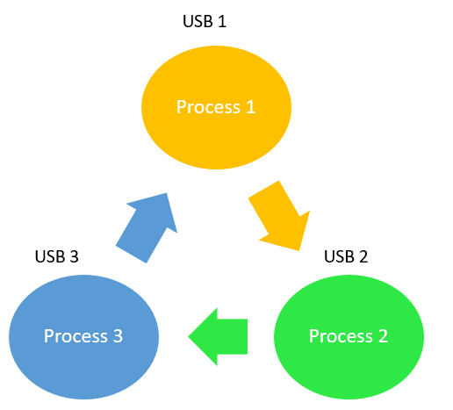
Example of Circular Wait

Slide 12
Q1) Which of the following condition is required for a deadlock to be possible?
a) Mutual exclusion
b) A process may hold allocated resources while awaiting assignment of other resources
c) No resource can be forcibly removed from a process holding it d) All of the mentioned

Slide 13
Q2) The circular wait condition can be prevented by :-
a) Defining a linear ordering of resource types b) Using thread c) Using pipes d) All of the mentioned

Slide 14
2) System Resource Allocation Graph
The system reallocation graph is a directed graph that briefs you about the deadlock more precisely. Like every graph, it also has a set of vertices and a set of edges. Further, the set of vertices can be classified into two types of nodes P and R.
Where P is the set of vertices indicating the set of active processes and R is the set of vertices indicating all types of resources in the system.
When a process requests for a resource it denoted by the request edge in the resource-allocation graph. The request edge is a directed edge from the requesting process P_{i} to requested resource R_{j} i.e. P_{i} -> R_{j}.

Slide 15
Well, when a resource is allotted to some process then it is denoted by the assignment edge. The assignment edge is the directed edge from the instance of resource R_{j} to the process P_{i} i.e. R_{j} -> P_{i}.
In the graph, resources are denoted by the rectangles and the processes are denoted by the circles. If a resource has multiple instances then it is denoted by the dots inside the rectangle.
When a process request for an instance of the resource it directs a request edge to the resource. If the resource is able to allocate the resource instance to the requesting process then immediately the request edge is converted to assignment edge.
The request edge always points to the resource rectangle in the graph, not to dots (instance) inside the rectangle. Although the assignment edge nominates the dot (instance) to a process.

Slide 16
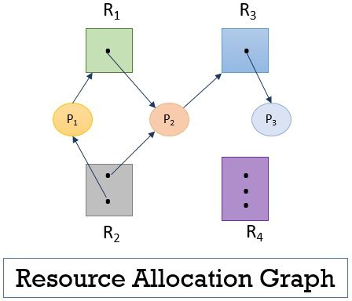
Resource Allocation Graph
Figure 1 Resource Allocation

Slide 17
To understand deadlock we let us take an example. Consider we have following set of nodes and edges.
There are three active processes P = {P₁, P₂, P₃}
There are four resources R = { R_{1,} R₂, R₃, R₄}
The set of request edge and assignment edges we have
E = { P1 -> R₁, P₂ -> R₃, R₁ -> P₂, R₂ -> P₂, R₂ -> P₁, R₃ -> P₃}
Observe the previous figure 1 above that the resource R₁ has only one instance, resource R₂ has two instances, resource R₃ has one instance, and resource R₄ has three instances. Let us check the status of the processes.

Slide 18
The previous figure1 shows that the process P₁ has requested for the instance of resource R₁ is already holding the instance of resource R₂.
The process P₂ has requested for the instance of resource R₃ and is already holding the instances of resource R₁ and R₃.
The process P₃ has not requested for any resource instance but is holding the instance for resource R₃.

Slide 19
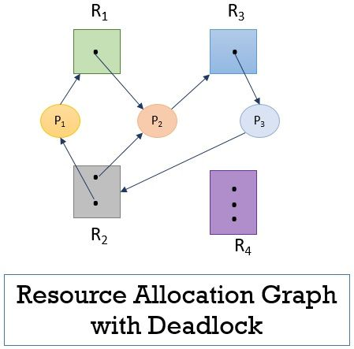
Resource Allocation with Deadlock
Figure 2 Resource Allocation with Deadlock
Process P₁, P₂ and P₃ are now in deadlock as each process in the cycle is waiting for the resource held by another process.
But every cycle in the resource allocation graph does not indicate the deadlock, you have to observe the cycle carefully while dealing with deadlock problem. So, this is how you can characterize the deadlock in the system.

Slide 20
Remember if the resource allocation graph has a cycle and every resource has a single instance then it implies that a deadlock has occurred. In case, the resources have multiple instances then a cycle in the graph need not be indicating the occurrence of deadlock.
Consider that the process P₃ is requesting for the instance of resource R₂ which is already held by the process P₁ and P₂. In this case, you will observe that there are two cycles in the resource allocation graph:
P₁ -> R ₁ -> P₂ -> R₃ -> P₃ -> R₂ -> P₁
P₂ -> R₃ -> P₃ -> R₂ -> P₂

Slide 21
Q1) If the wait for graph contains a cycle that means:
a) Then a deadlock does not exist
b) Then a deadlock exists
c) Then the system is in a safe state
d) Either deadlock exists or system is in a safe state

Slide 22
Q2) An edge from process Pi to Pj in a wait for graph indicates
a) Pi is waiting for Pj to release a resource that Pi needs b) Pj is waiting for Pi to release a resource that Pj needs c) Pi is waiting for Pj to leave the system d) Pj is waiting for Pi to leave the system

